Slide 1

Understanding Organisational Abuse, Neglect, and Acts of Omission
Promoting safer environments by recognising and reporting issues
Notes:
--- This presentation addresses the critical issues of organisational abuse, neglect, and acts of omission within care settings. We will explore definitions, environments at risk, recognition of indicators, reporting procedures, comparisons, and lessons learned to promote safer care environments. Image source: Microsoft 365 content library

Slide 2

Presentation Agenda
Setting the Scene – Whorlton Hall and Conifer Lodge
Overview of Organisational Abuse, Neglect, and Acts of Omission
Comparing Organisational Abuse and Acts of Omission
Environments Where Abuse and Neglect Can Occur
Recognising Indicators of Organisational Abuse and Acts of Omission
Reporting and Responding to Concerns
Notes:
--- We will begin by defining organisational abuse, neglect, and acts of omission, followed by identifying environments where these issues occur. Next, we will discuss how to recognise indicators, the importance of reporting concerns, compare abuse with acts of omission, and conclude with learning from case reviews and recommendations. Image source: Microsoft 365 content library

Slide 3



Whorlton Hall durham
Notes:
--- This slide references information from the following file: https://office.com?path=9fb2bf03-f9f2-42d1-a7b5-cc0653f6a6b9 Overview, Investigation Findings, Key Lessons for Management (Part 1), Key Lessons for Management (Part 2), Key Lessons for Management (Part 3), Conclusion

Slide 4

Overview
Independent hospital in Barnard Castle, County Durham
Operated by Cygnet Healthcare since January 2019 (acquired from Danshell in August 2018)
Registered with Care Quality Commission (CQC) for:
Treatment for disease, disorder, or injury
Assessment/medical treatment for persons detained under the Mental Health Act 1983
Notes:
--- This slide references information from the following file: https://office.com?path=9fb2bf03-f9f2-42d1-a7b5-cc0653f6a6b9 Between July 2022 and early 2023, multiple whistleblower reports raised serious safeguarding concerns at Conifer Lodge, a care facility located in South Shields, Tyne and Wear. These reports focused primarily on the conduct of the manager, William Malcolm, who was accused of engaging in inappropriate behavior with residents. Allegations included simulated sexual acts, unwanted physical contact, and verbal abuse. The gravity of these claims led to Malcolm's suspension and subsequent criminal charges. His trial is scheduled for February 2025. The overview highlights the initial emergence of concerns and sets the stage for understanding the broader implications of the safeguarding failures at the facility. Image source: Microsoft 365 content library

Slide 5
Admitted men and women (18+) with learning disabilities and/or autism
Patients may have additional mental/physical needs and challenging behaviors
In May 2019: 13 patients, placements commissioned by 10 Clinical Commissioning Groups
BBC Panorama Programme (22 May 2019) exposed alleged psychological and physical abuse by staff Whorlton Hall BBC Panorama May 2019
Immediate suspension of staff after broadcast
All 13 residents moved to other care settings
Whorlton Hall Closed following the revelations
Notes:
--- This slide references information from the following file: https://office.com?path=9fb2bf03-f9f2-42d1-a7b5-cc0653f6a6b9 Between July 2022 and early 2023, multiple whistleblower reports raised serious safeguarding concerns at Conifer Lodge, a care facility located in South Shields, Tyne and Wear. These reports focused primarily on the conduct of the manager, William Malcolm, who was accused of engaging in inappropriate behavior with residents. Allegations included simulated sexual acts, unwanted physical contact, and verbal abuse. The gravity of these claims led to Malcolm's suspension and subsequent criminal charges. His trial is scheduled for February 2025. The overview highlights the initial emergence of concerns and sets the stage for understanding the broader implications of the safeguarding failures at the facility. Image source: Microsoft 365 content library

Slide 6
Legal and Procedural Actions
Individuals charged with criminal offences (ill-treatment or wilful neglect by care workers)
Precautions taken in reporting to avoid prejudicing ongoing criminal proceedings
Notes:
--- This slide references information from the following file: https://office.com?path=9fb2bf03-f9f2-42d1-a7b5-cc0653f6a6b9 Between July 2022 and early 2023, multiple whistleblower reports raised serious safeguarding concerns at Conifer Lodge, a care facility located in South Shields, Tyne and Wear. These reports focused primarily on the conduct of the manager, William Malcolm, who was accused of engaging in inappropriate behavior with residents. Allegations included simulated sexual acts, unwanted physical contact, and verbal abuse. The gravity of these claims led to Malcolm's suspension and subsequent criminal charges. His trial is scheduled for February 2025. The overview highlights the initial emergence of concerns and sets the stage for understanding the broader implications of the safeguarding failures at the facility. Image source: Microsoft 365 content library

Slide 7
Wider Context – Transforming Care Programme
Established after 2011 Serious Case Review into Winterbourne View Hospital abuse
Aims to prevent inappropriate placement of people with learning disabilities/autism in mental health settings or Assessment and Treatment Units (ATUs)
Panorama programme raised urgent questions about continued inappropriate placements
Notes:
--- This slide references information from the following file: https://office.com?path=9fb2bf03-f9f2-42d1-a7b5-cc0653f6a6b9 Between July 2022 and early 2023, multiple whistleblower reports raised serious safeguarding concerns at Conifer Lodge, a care facility located in South Shields, Tyne and Wear. These reports focused primarily on the conduct of the manager, William Malcolm, who was accused of engaging in inappropriate behavior with residents. Allegations included simulated sexual acts, unwanted physical contact, and verbal abuse. The gravity of these claims led to Malcolm's suspension and subsequent criminal charges. His trial is scheduled for February 2025. The overview highlights the initial emergence of concerns and sets the stage for understanding the broader implications of the safeguarding failures at the facility. Image source: Microsoft 365 content library

Slide 8
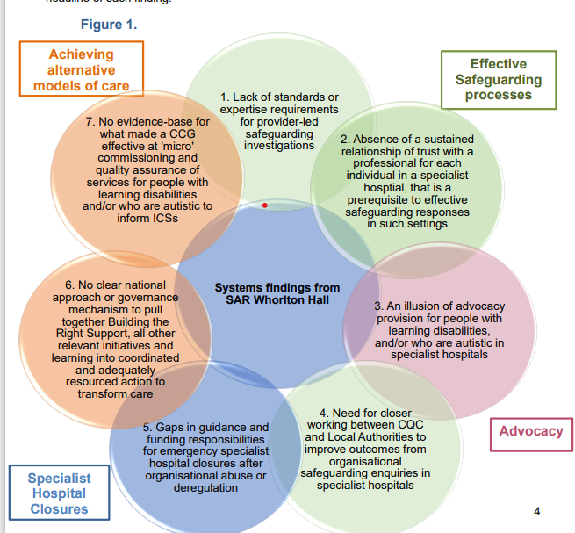
Notes:
--- This slide references information from the following file: https://office.com?path=9fb2bf03-f9f2-42d1-a7b5-cc0653f6a6b9 Between July 2022 and early 2023, multiple whistleblower reports raised serious safeguarding concerns at Conifer Lodge, a care facility located in South Shields, Tyne and Wear. These reports focused primarily on the conduct of the manager, William Malcolm, who was accused of engaging in inappropriate behavior with residents. Allegations included simulated sexual acts, unwanted physical contact, and verbal abuse. The gravity of these claims led to Malcolm's suspension and subsequent criminal charges. His trial is scheduled for February 2025. The overview highlights the initial emergence of concerns and sets the stage for understanding the broader implications of the safeguarding failures at the facility. Image source: Microsoft 365 content library

Slide 9
Conifer lodge south tyneside
Notes:
--- This slide references information from the following file: https://office.com?path=9fb2bf03-f9f2-42d1-a7b5-cc0653f6a6b9 Overview, Investigation Findings, Key Lessons for Management (Part 1), Key Lessons for Management (Part 2), Key Lessons for Management (Part 3), Conclusion

Slide 10
Overview
Specialisms / Services
Caring for adults under 65 yrs
Dementia
Learning Disabilities
Physical disabilities
Between July 2022 and early 2023, whistleblower reports and subsequent investigations revealed serious safeguarding concerns at Conifer Lodge, centering on the conduct of the Home manager (who was a registered nurse)
Notes:
--- This slide references information from the following file: https://office.com?path=9fb2bf03-f9f2-42d1-a7b5-cc0653f6a6b9 Between July 2022 and early 2023, multiple whistleblower reports raised serious safeguarding concerns at Conifer Lodge, a care facility located in South Shields, Tyne and Wear. These reports focused primarily on the conduct of the manager, William Malcolm, who was accused of engaging in inappropriate behavior with residents. Allegations included simulated sexual acts, unwanted physical contact, and verbal abuse. The gravity of these claims led to Malcolm's suspension and subsequent criminal charges. His trial is scheduled for February 2025. The overview highlights the initial emergence of concerns and sets the stage for understanding the broader implications of the safeguarding failures at the facility. Image source: Microsoft 365 content library

Slide 11
Calling one resident who had several mental and physical health problems, names such as a "fat f*****" and a "fat ****“and grabbing their testicles.
Calling a pensioner a "slapper" and making comments about their son. He is also accused of kissing them on the lips.
Kissing another resident on the lips on at least three occasions. Prosecutors say he also sexually assaulted them after they fell back on the bed and he allegedly thrust himself towards them.
He is also accused of sexually assaulting another resident while they were on a rocking chair and he is said to have got on top of them
Further accusations of sexually assaulting three females who were not residents at the home.
Notes:
--- This slide references information from the following file: https://office.com?path=9fb2bf03-f9f2-42d1-a7b5-cc0653f6a6b9 Between July 2022 and early 2023, multiple whistleblower reports raised serious safeguarding concerns at Conifer Lodge, a care facility located in South Shields, Tyne and Wear. These reports focused primarily on the conduct of the manager, William Malcolm, who was accused of engaging in inappropriate behavior with residents. Allegations included simulated sexual acts, unwanted physical contact, and verbal abuse. The gravity of these claims led to Malcolm's suspension and subsequent criminal charges. His trial is scheduled for February 2025. The overview highlights the initial emergence of concerns and sets the stage for understanding the broader implications of the safeguarding failures at the facility. Image source: Microsoft 365 content library

Slide 12
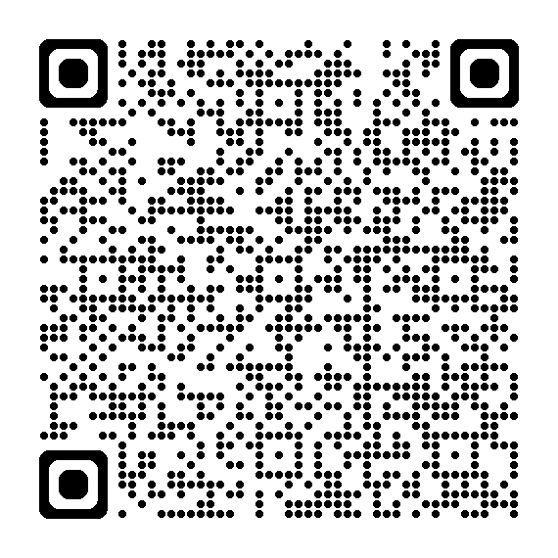
Following receipt of the two whistleblowing reports, a police investigation commenced, and the manager was suspended.
He stood trial in early 2025
He was found guilty of 13 offences – 10 charges of sexual assault, two of ill-treating a person in care and one racially aggravated harassment.
He was sentenced to three years and three months’ imprisonment
As a REGISTERED NURSE this was a PERSON IN A POSITION OF TRUST
Notes:
--- This slide references information from the following file: https://office.com?path=9fb2bf03-f9f2-42d1-a7b5-cc0653f6a6b9 Between July 2022 and early 2023, multiple whistleblower reports raised serious safeguarding concerns at Conifer Lodge, a care facility located in South Shields, Tyne and Wear. These reports focused primarily on the conduct of the manager, William Malcolm, who was accused of engaging in inappropriate behavior with residents. Allegations included simulated sexual acts, unwanted physical contact, and verbal abuse. The gravity of these claims led to Malcolm's suspension and subsequent criminal charges. His trial is scheduled for February 2025. The overview highlights the initial emergence of concerns and sets the stage for understanding the broader implications of the safeguarding failures at the facility. Image source: Microsoft 365 content library

Slide 13
Investigation Findings
Inappropriate Behavior Pattern
Investigation revealed a disturbing pattern of inappropriate behavior impacting multiple residents at Conifer Lodge.
Staff Involvement and Interviews
Several staff were implicated or interviewed, highlighting concerns about internal oversight and accountability.
Systemic Safeguarding Failures
No Safeguarding Adult Review referrals were submitted, indicating systemic failures in facility response mechanisms.
Legal Proceedings Complexity
Some allegations led to legal actions, while others lacked sufficient evidence, complicating justice efforts.
Notes:
--- This slide references information from the following file: https://office.com?path=9fb2bf03-f9f2-42d1-a7b5-cc0653f6a6b9 The investigation into Conifer Lodge revealed a disturbing pattern of inappropriate behavior by William Malcolm, affecting at least eight residents who required Safeguarding Adult Review (SAR) referrals. Several staff members were either implicated or interviewed during the inquiry. Despite the severity of the situation and the convening of Gold group meetings, no SARs were submitted at the time of reporting. This lack of formal safeguarding action underscores systemic failures in the facility’s response mechanisms. Additionally, while some allegations led to legal proceedings, others were not charged due to insufficient evidence, further complicating the pursuit of justice and accountability. Image source: Microsoft 365 content library

Slide 14

Key Learning
Importance of Proactive Safeguarding
A proactive safeguarding culture is vital to prevent failures and protect vulnerable individuals. Timely response to whistleblower reports will prevent harm and supports vulnerable individuals effectively
Whistleblower Protection
Strengthening protections and confidential channels encourages staff to report concerns safely.
Clear Documentation and Accountability
Documenting all concerns clearly ensures accountability and proper escalation within management.
This Photo by Unknown Author is licensed under CC BY-SA
Notes:
--- This slide references information from the following file: https://office.com?path=9fb2bf03-f9f2-42d1-a7b5-cc0653f6a6b9 The first set of lessons for management emphasizes the importance of prompt and transparent safeguarding actions. Delays in responding to whistleblower reports and submitting SARs can exacerbate harm to vulnerable individuals. Management must ensure that all concerns are escalated and reviewed promptly, with clear documentation to support accountability. Additionally, the role of whistleblowers in exposing misconduct was pivotal. Therefore, it is essential to strengthen whistleblower protections, provide comprehensive training, and establish confidential reporting channels. These measures foster a culture of openness and safety, enabling staff to report concerns without fear of retaliation. Image source: Microsoft 365 content library

Slide 15
Key Learning
Leadership Oversight Importance
Effective leadership oversight and accountability prevent safeguarding failures and ensure misconduct does not persist.
Regular Reviews and Escalation
Management must conduct regular reviews and establish clear escalation pathways for swift issue resolution.
Multi-agency Collaboration
Clear roles and responsibilities and timely action tracking improve collaboration across safeguarding agencies.
This Photo by Unknown Author is licensed under CC BY-SA
Notes:
--- This slide references information from the following file: https://office.com?path=9fb2bf03-f9f2-42d1-a7b5-cc0653f6a6b9 The first set of lessons for management emphasizes the importance of prompt and transparent safeguarding actions. Delays in responding to whistleblower reports and submitting SARs can exacerbate harm to vulnerable individuals. Management must ensure that all concerns are escalated and reviewed promptly, with clear documentation to support accountability. Additionally, the role of whistleblowers in exposing misconduct was pivotal. Therefore, it is essential to strengthen whistleblower protections, provide comprehensive training, and establish confidential reporting channels. These measures foster a culture of openness and safety, enabling staff to report concerns without fear of retaliation. Image source: Microsoft 365 content library

Slide 16
Key Learning
Support for Affected Individuals
Management must provide immediate and ongoing support to residents and staff impacted by safeguarding failures to ensure well-being.
Training,Culture and Embedding Continuous Learning
Organisations should foster a culture of continuous learning to improve safeguarding practices and prevent future failures which includes the provision of appropriate training and fostering openness builds a supportive culture against misconduct.
Regular Audit and Reviews
Regular audits and thorough reviews of lessons learned are essential for updating policies and training programmes effectively
This Photo by Unknown Author is licensed under CC BY-SA
Notes:
--- This slide references information from the following file: https://office.com?path=9fb2bf03-f9f2-42d1-a7b5-cc0653f6a6b9 The first set of lessons for management emphasizes the importance of prompt and transparent safeguarding actions. Delays in responding to whistleblower reports and submitting SARs can exacerbate harm to vulnerable individuals. Management must ensure that all concerns are escalated and reviewed promptly, with clear documentation to support accountability. Additionally, the role of whistleblowers in exposing misconduct was pivotal. Therefore, it is essential to strengthen whistleblower protections, provide comprehensive training, and establish confidential reporting channels. These measures foster a culture of openness and safety, enabling staff to report concerns without fear of retaliation. Image source: Microsoft 365 content library

Slide 17
Overview of Organisational Abuse, Neglect, and Acts of Omission

Slide 18

What is organisational abuse?
Organisational abuse involves systemic failures causing harm or poor care beyond individual actions.
“It includes neglect and poor care practice within a specific care setting. This could be a hospital or a care home, but also the care you receive in your own home” Care Act 2014.
Notes:
It includes neglect and poor care practice within a
specific care setting. This could be a hospital or a care home, but also the care
received in one’s own home. --- Organisational abuse refers to systemic failures that result in poor care or harm, including neglect by institutions rather than individuals. Understanding this helps identify responsibilities beyond frontline staff to the wider organisation. Image source: Microsoft 365 content library

Slide 19

What is neglect and Acts of Omission?
Definition of Acts of Omission
Acts of omission refer to failures to provide essential care or support in critical situations.
Types of Omissions
Common omissions include neglecting health needs and safety precautions in caregiving environments.
Impact on Well-being
Omissions can severely harm individuals’ health, safety, and overall well-being in care settings.
Notes:
--- Acts of omission involve failures to provide necessary care or support, such as neglecting health needs or safety measures. These omissions can severely affect individuals’ well-being and safety in care environments. Image source: Microsoft 365 content library

Slide 20

Common Characteristics and Associated Risks
Inadequate Staffing
Insufficient staff levels can lead to neglect and increase the risk of harm to vulnerable individuals.
Poor Management
Ineffective leadership and oversight contribute to unsafe care environments and abuse risks.
Lack of Training
Insufficient staff training increases vulnerability and potential for neglect within care settings.
Notes:
--- Organisational abuse and neglect often display patterns like inadequate staffing, poor management, and lack of training, which increase risks of harm and vulnerability within care settings. Image source: Microsoft 365 content library

Slide 21
Comparing Organisational Abuse and Neglect /Acts of Omission

Slide 22

Key Similarities and Shared Warning Signs
Systemic Failures
Both cases involve systemic failures that negatively affect the quality of care and operations.
Poor Management
Poor management practices contribute significantly to degraded care quality and operational issues.
Inadequate Resources
Insufficient resources cause recurring neglect and undermine effective care delivery.
Recurring Neglect
Repeated neglectful practices highlight failures in maintaining adequate standards.
Notes:
--- Both involve systemic failures impacting care quality, with warning signs including poor management, inadequate resources, and recurring neglectful practices. Image source: Microsoft 365 content library

Slide 23

Distinct Differences
Organisational Abuse
Organisational abuse involves intentional or systemic harm caused by policies or practices within an organization.
Acts of Omission
Acts of omission are failures to act, often due to neglect or oversight, leading to harm through inaction.
Notes:
--- Organisational abuse is broader and intentional or systemic harm, whereas acts of omission specifically refer to failures to act, often due to neglect or oversight. Image source: Microsoft 365 content library

Slide 24
Recognising Indicators of Organisational Abuse and Acts of Omission

Slide 25

EXAMPLES OF ORGANISATIONAL ABUSE
Inappropriate use of power or control.
Inappropriate confinement, restraint, or restriction.
Lack of choice – in food, in decoration, in lighting and heating, and in other environmental aspects.
Lack of personal clothing or possessions.
No flexibility of schedule, particularly with bed times.
Financial abuse.
Physical or verbal abuse.
Notes:
--- Consistent delays, omissions in treatment, lack of personalised care, and unprofessional behaviour by staff may indicate organisational failings. Image source: Microsoft 365 content library

Slide 26
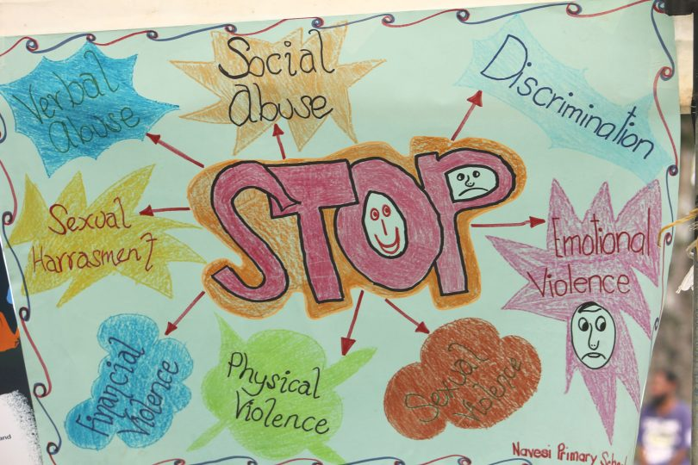
SIGNS OF ORGANISATIONAL ABUSE
An unsafe, unhygienic or overcrowded environment.
A strict or inflexible routine.
Lack of privacy, dignity, and respect for people as individuals.
Withdrawing people from community or family contacts.
No choice offered with food, drink, dress or activities.
No respect or provisions for religion, belief, or cultural backgrounds.
Treating adults like children, including arbitrary decision-making.
Look out for more telling signs of abuse, including cuts, bruises, and restraint and be aware if the organisation discourages visits, or the involvement of friends and relatives.
Notes:
--- Consistent delays, omissions in treatment, lack of personalised care, and unprofessional behaviour by staff may indicate organisational failings. Image source: Microsoft 365 content library

Slide 27

EXAMPLES OF Neglect and Acts of omission
Ignoring medical needs: Failing to provide necessary medical attention or treatment.
Withholding necessities of life: Not providing adequate nutrition, medication, or heating.
Inadequate supervision: Failing to monitor individuals who require assistance, leading to potential harm.
Failure to address known abuse: Not taking action when aware of abuse occurring.
Ignoring emotional needs: Neglecting the emotional well-being of individuals in care.
Notes:
--- Consistent delays, omissions in treatment, lack of personalised care, and unprofessional behaviour by staff may indicate organisational failings. Image source: Microsoft 365 content library

Slide 28

SIGNS OF neglects and acts of omission
Increase in falls
Mismanaged conditions such as Diabetes / Pressure Ulcers / Skin Viability
Loss of weight
Signs of hypothermia
Appearance and presentation
Increased confusion
Agitation
Notes:
--- Consistent delays, omissions in treatment, lack of personalised care, and unprofessional behaviour by staff may indicate organisational failings. Image source: Microsoft 365 content library

Slide 29

Impact on Individuals
Physical Harm
Abuse and neglect can cause significant physical injuries and deterioration of health in individuals.
Emotional Distress
Victims often suffer emotional pain, anxiety, and trauma due to mistreatment or neglect.
Loss of Dignity
Abuse can lead to a profound loss of self-respect and personal dignity among service users.
Diminished Trust
Trust in care providers and services is often weakened or lost after abuse or neglect occurs.
Notes:
--- The consequences of abuse and omissions include physical harm, emotional distress, loss of dignity, and diminished trust in care services. Image source: Microsoft 365 content library

Slide 30
Environments Where Abuse and Neglect Can Occur

Slide 31

High Dependency Needs
Residents often have complex and high dependency needs requiring specialized care and attention.
Organisational Challenges
Operational and resource challenges in these settings can impact quality of care and safety.
Risk of Abuse and Neglect
Complex needs and organisational issues may increase the risk of abuse or neglect in care settings.
Notes:
--- Care homes, hospitals, and supported living environments are commonly at risk due to complex needs, high dependency, and organisational challenges, which can contribute to abusive or neglectful situations. Image source: Microsoft 365 content library

Slide 32

Risk Factors Within Organisations and Systems
Staff Shortages
Lack of sufficient staff increases workload and stress, raising risks of errors and neglect.
Inadequate Training
Poor training reduces staff competence and ability to manage complex situations effectively.
Poor Communication
Miscommunication or lack of communication causes misunderstandings and operational failures.
Resource Constraints
Limited resources hinder proper support and increase vulnerability to organisational abuse.
Notes:
--- Staff shortages, inadequate training, poor communication, and resource constraints are systemic risk factors that can contribute to organisational abuse and neglect. Image source: Microsoft 365 content library

Slide 33
Role of Institutional Culture and Leadership
Impact of Leadership
Effective leadership directly influences care standards and fosters a culture of safeguarding.
Organisational Culture
A positive organisational culture promotes high care standards and reduces risk of abuse and neglect.
Risks of Poor Culture
Cultures tolerating poor practices increase the chances of abuse and neglect within care institutions.
Notes:
--- Leadership practices and organisational culture greatly impact care standards; cultures that tolerate poor practices or fail to promote safeguarding increase the likelihood of abuse and neglect. Image source: Microsoft 365 content library

Slide 34
Reporting and Responding to Concerns

Slide 35

Reporting Mechanisms and Safeguarding Procedures
Clear Reporting Processes
Care settings need well-defined procedures for reporting concerns promptly and effectively.
Designated Safeguarding Leads
Designated safeguarding leads oversee concerns and ensure proper action to protect individuals.
Protection Protocols
Protocols are essential to safeguard individuals from harm within care environments.
Notes:
--- Care settings must have clear processes for reporting concerns, including designated safeguarding leads and protocols to protect individuals from harm. Image source: Microsoft 365 content library

Slide 36

Barriers to Reporting
Fear of Retaliation
Fear of retaliation often stops individuals from reporting issues, creating a culture of silence and mistrust.
Lack of Awareness
Many do not report due to lack of awareness about reporting mechanisms and their rights within the organization.
Encouraging Open Communication
Promoting open communication helps build trust and empowers individuals to report concerns safely.
Protecting Reporters
Ensuring protection and anonymity for reporters is critical to overcoming barriers and fostering a safe reporting culture.
Notes:
--- Fear of retaliation, lack of awareness, and organisational culture may prevent reporting. Encouraging open communication and protecting reporters are essential for overcoming these barriers. Image source: Microsoft 365 content library

Slide 37
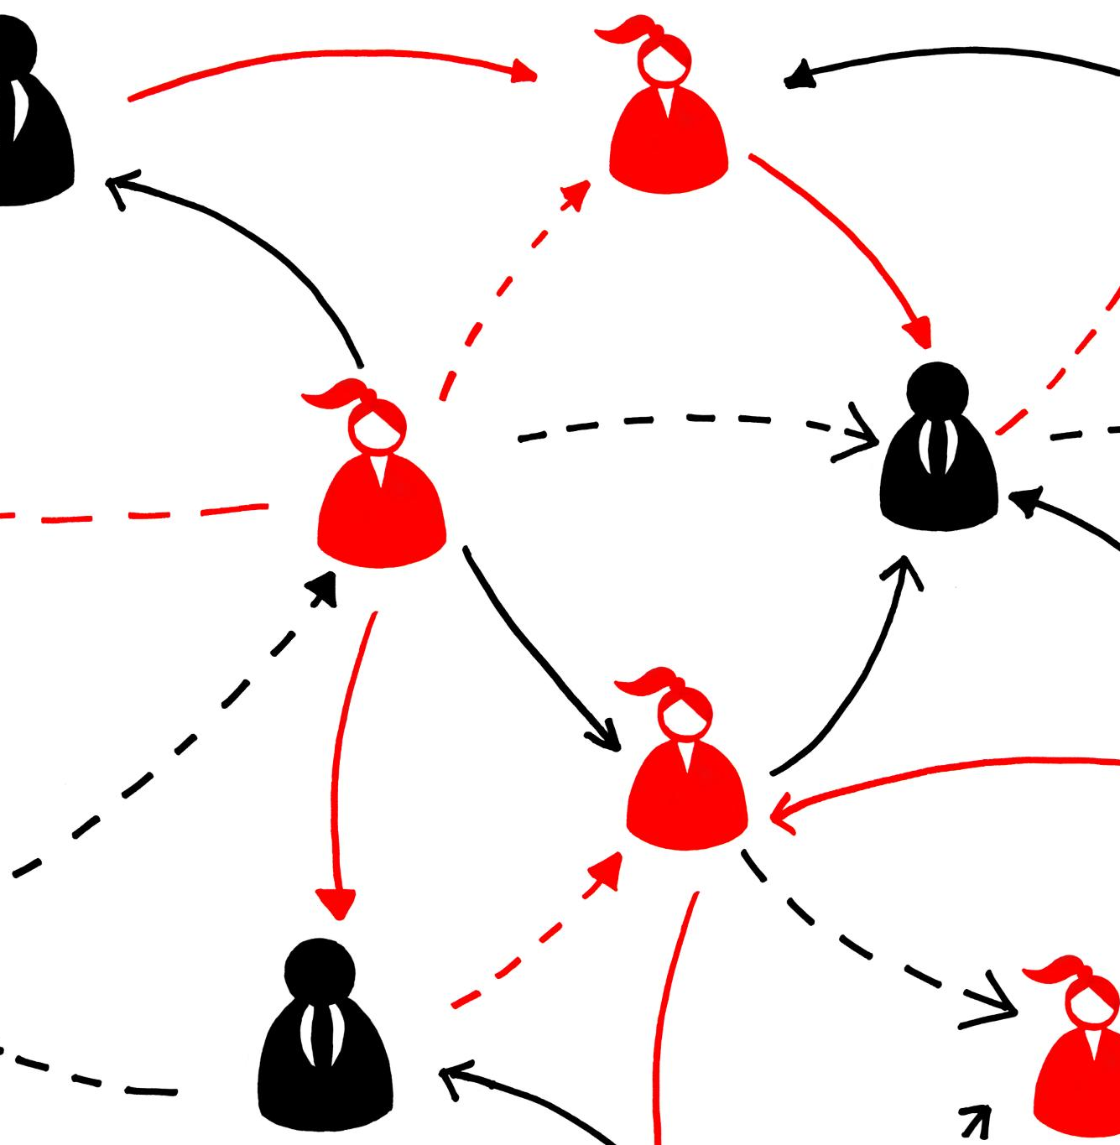
Role of Whistleblowing and External Oversight
Whistleblowing Importance
Whistleblowing allows staff to safely report concerns without fear of retaliation, promoting transparency and safety.
External Oversight Role
External bodies monitor and ensure accountability to uphold high care standards and protect public interest.
Notes:
--- Whistleblowing enables staff and others to raise concerns safely. External bodies provide oversight and ensure accountability to uphold care standards. Image source: Microsoft 365 content library

Slide 38
Conclusion
Challenges in Care Settings
Organisational abuse, neglect, and omission are critical challenges affecting vulnerable individuals in care facilities.
Importance of Awareness
Raising awareness is essential to identify and prevent abuse and neglect in care environments.
Systemic Improvements
Implementing systemic improvements helps safeguard individuals and maintain high care standards.
Notes:
Organisational abuse, neglect, and acts of omission present serious challenges in care settings. Awareness, recognition, reporting, and systemic improvements are essential to safeguard vulnerable individuals and uphold care standards.

Slide 39



What can I do now?
Resources - Organisational Abuse Toolkit and Resources
Further Training Opportunities: Safeguarding training - South Tyneside Council
Report Concerns: DSL / Safeguarding Lead / Whistleblowing / Lets Talk 0191 424 6000 / CQC

Slide 40


