Slide 1









Complex Adult Risk Management (CARM)
Safeguarding Week; November 2025
Yasmeen Akhtar and Rosie Todd
Notes:
Hi everyone
Some context – we recognise the need for a multi-agency approach and the Alan SAR in Sunderland was the catalyst for the Complex Adults Risk Management (CARM) approach there. Alan was a 53 year-old man who died as a result of an accident with a fire caused by a cigarette in a garage where he was sleeping for the night, Alan had a pattern of involvement with health, social care and criminal justice
services throughout his adult life. This was underpinned by his chronic alcohol dependency, with Alan having begun drinking at 15 years of age. He lived a chaotic lifestyle and at the time of his death Alan was homeless and subject to statutory safeguarding, though sadly he died before any meaningful safeguarding work was undertaken. The SAR recommended better ways of working and CARM aims to further develop different approaches for people like Alan – where we’re better able to understand ACE and practice in a trauma-informed approach that is strength-focused and allows people like Alan see that people do care.
CARM provides a framework for professionals to facilitate effective multiagency working with adults at risk who are deemed to have mental capacity and who are at risk of serious harm or death through self neglect, refusal of services and/or high levels of Sunderland had a SAR
Today ‘s session will provide you with a brief introduction to the CARM framework.
• Its uses and benefits
• Key principles and themes underpinning practice
• Practical application of the process
• Feel confident about using this process as a tool to:
- Prevent escalation of risks
- Address disengagement and vulnerability factors impacting on this
Secure better outcomes for adults whose wellbeing and safety may be at risk

Slide 2
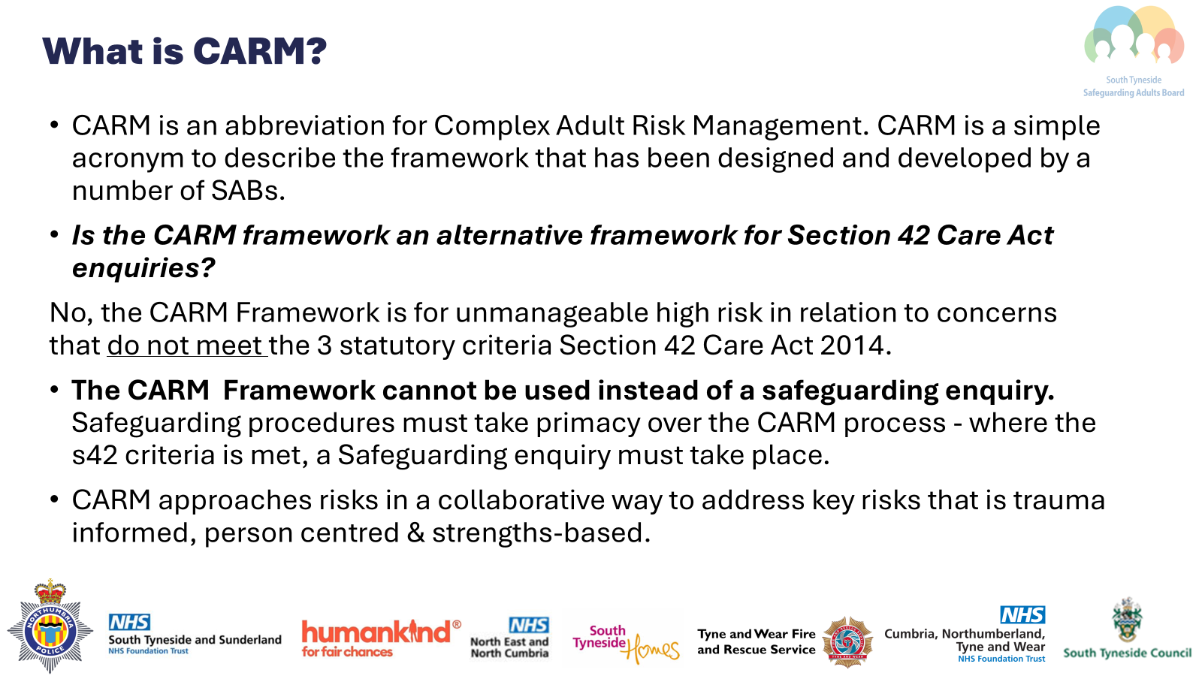

Slide 3
What is the purpose of the CARM framework?
The CARM framework is a Local Safeguarding Adult Board approach that brings together professionals from health, social care, the police, housing and other agencies/organisations. This also includes the adult, family members and friends who have a legitimate relationship with the adult.
This framework will be useful to professionals working with Adults who are experiencing a high level of risk from events and circumstances that result in risk of harm to them.
CARM should not be overused.
Notes:
The CARM framework is likely to be useful to anybody working with an adult who is experiencing or at risk of an unmanageable level of risk as a result of circumstances which create the risk of significant harm to themselves or others but is not relating to abuse or neglect by a 3rd party.
It is a SG approach that brings together the adult and those working with them and family or friends.
This framework should be used flexibly and in a way that achieves the best outcomes for the adult. The framework doesn’t specify which agencies are involved nor prescribe any specific actions, as these will be decided on a case-by-case basis coordinated through multi-agency working in line with the principles of MSP that supports decision-making and works in partnership with the adult to achieve the desired outcomes.

Slide 4
CARM criteria
The s42 duty DOES NOT apply.
There is a risk of serious harm (physical or psychological) which is life-threatening and/or traumatic, and which is viewed to be imminent or very likely to occur, or death or due to non-engagement with services and they do not meet the criteria for a safeguarding referral; OR
There is the potential of death and or life changing injuries and/or a potential risk to the health and safety of others.
There is a high level of concern from partner agencies.
The adult has the mental capacity to make decisions and choices about their life.

Slide 5
Do you need consent from the adult?
The adult and their representatives should be invited to the meeting, where possible.
This needs to be demonstrated clearly and any decision not to seek consent, or to override the adult consent there should have a lawful basis to this decision making and it should be clearly recorded.
Notes:
It is important to gain consent and discuss with the adult the reason for referring to CARM, their involvement and maximising participation. Always consider advocacy throughout the CARM process.
It does not mean that CARM cannot be used without consent, but any decision to proceed without consent should have a basis in law and be clearly recorded.
The adult should be at the centre and be involved, so CARM can only be held with a person who understands the risks. Understanding capacity to make decision is a vital element of planning with an adult.
Where it has been determined the adult does not have capacity in relation to the nature and degree of risk, then any decisions should be in accordance with the MCA and BI decision-making and where appropriate Best Interest Decision making meetings should be held instead.

Slide 6
How to refer to CARM
CARM referral forms can be obtained from the STSAB website and should be emailed to the MASH team :SouthTynesideMASHmailbox@northumbria.police.uk
Consideration should always be given to Adult Safeguarding Section 42 Duties:
  Safeguarding procedures must take primacy over the CARM process - where the s42 criteria is met, a Safeguarding enquiry must take place. DO NOT progress the CARM referral & refer to Safeguarding.
The Adult at Risk must consent to the referral, any decision not to seek consent, or to override the adult’s consent should have a lawful basis and it should be clearly recorded.
CARM meetings will be held on MS Teams unless the referrer or Adult at Risk wishes to meet in person. Where this is the case, it is the responsibility of the referrer to arrange a suitable venue.

Slide 7
How is the CARM governed?
The Governance of the CARM framework will sit with the Safeguarding Adult Board (SAB) and the SAB will receive reports from the relevant Subgroups.
Data collection might include:
  • Number of adults going through the CARM process
  • Agencies referring to CARM
  • Outcomes for adults
  • Escalation processes
Notes:
As like all new ways of working it is anticipated that the CARM model will be reviewed at appropriate points throughout the year.

Slide 8

Feedback
Individual, partners and your organisation

Slide 9
Emerging Themes
Consent and Involvement: 41% of referrals were made without the person’s awareness. While this can be justified in some cases, the framework must continue to promote inclusion and empowerment.
Referral Quality: Some referrals bypass safeguarding considerations, resulting in inappropriate CARM meetings.
Risk Assessment: A risk rating tool has been introduced but is still embedding.
Meeting Attendance: Engagement is inconsistent, and coordination is hindered by unclear contact points and inconsistent representation.
Positive Impact: Feedback from professionals and adults at risk highlights the value of CARM in enabling holistic, proactive support.

Slide 10
Do you need consent from the Adult ?
The adult and their representatives should be invited to the meeting, where possible.
This needs to be demonstrated clearly and any decision not to seek consent, or to override the adult consent there should have a lawful basis to this decision making and it should be clearly recorded.
Notes:
It is important to gain consent and discuss with the adult the reason for referring to CARM, their involvement and maximising participation. Always consider advocacy throughout the CARM process.
It does not mean that CARM cannot be used without consent, but any decision to proceed without consent should have a basis in law and be clearly recorded.
The adult should be at the centre and be involved, so CARM can only be held with a person who understands the risks. Understanding capacity to make decision is a vital element of planning with an adult.
Where it has been determined the adult does not have capacity in relation to the nature and degree of risk, then any decisions should be in accordance with the MCA and BI decision-making and where appropriate Best Interest Decision making meetings should be held instead.

Slide 11
Feedback
Working well ?
Could be better ?
Like the ability to refer complex/at risk patients who wouldn't meet threshold for safeguarding .
meets the recommendation from SAR "Alan“
Partners coming together/sharing information
process working well overall.
chairs thorough in exploring current risks, allow everyone to give their opinion/share relevant information during process.
would like them or family to attend meetings
incorporate the voice of the family / carer if not already sought
threshold meeting prior to multi agency partners attending a CARM panel
One designated chair (example; repeating)
Relevant attendance
Delays in meetings being sent out

Slide 12
Feedback cont’d
Working well ?
Could be better?
The transparency between organisations around roles, plans for support etc is good to have in this type of forum. The CARM helped with plans for people that are high risk but would not generally come under Care Act/safeguarding criteria, so it was an extra safety net for them. I also like the document that is provided to the individual around the CARM so their expectations around it's purpose are clear from the offset.
“I felt heard”
Sometimes partner attendance was poor. Or there were managers in attendance from partner agencies who did not know the person well, and the allocated workers had not been invited along.

Slide 13
Feedback Cont’d
Opportunities;
the person being part of the complex discussions was very beneficial. Encourage this
The person did feel very heard and acknowledged in these meetings and it also did give us good opportunities to explore alternative options that may have been missed otherwise
Continue with CARM; I think the process is really beneficial to have
Challenges;
Duplicating- ie: referring to CARM and outcome being to submit adult safeguarding
Difficult to get consent as sometimes decision for CARM is after contact and then trying to get in touch can be difficult
Sometimes not all relevant MDT participants are present such as the G.P which is imperative when assessing risks/concerns discussing lack of engagement previous history

Slide 14
CARM impact on risk and safeguarding – Outcomes for the Person
Strong community links; forged strong partnerships housing, which enables the team to reach individuals who may be harder to identify as being at risk.
Holistic assessment of needs; are crucial in understanding the full spectrum of needs. This means considering physical, emotional, social, mental, and environmental factors (collaborative MDT). Better coordination of care: The complexity of needs, especially for hard-to-engage individuals, is more effectively addressed when professionals from multiple fields work together.
Faster identification of unmet needs: Teams can provide a range of insights that may be missed by a single agency, improving the overall response.
Risk assessment tools; to identify both immediate and long-term risks, including self-neglect, domestic abuse, mental health crises, substance misuse, and financial exploitation.
Difficulties in getting full cooperation from the individual, especially when they are in denial about their needs or are reluctant to engage. Risk of underestimating some areas of risk, especially when a person is reluctant to share information.
Incorporating the perspectives of informal carers, where possible, can also provide important insights into the individual’s needs and preferences.
Safeguarding team; a process that enables oversight of risk through an multi-disciplinary approach through proportionality, whilst creating capacity (Professional burnout from prolonged, difficult cases can undermine the consistency needed to build strong relationships).
A strength based approach considers the individual’s values, preferences, and goals rather than just focusing on their deficits or risks. builds upon the person’s existing capabilities, resilience, and support systems, rather than framing them solely as a “problem”.
This approach helps empower individuals and reduces resistance to services by acknowledging their autonomy and dignity.

Slide 15
Complex Adult Risk Management in Adult Social Care focuses on supporting vulnerable adults who face multiple, intersecting risks—whether related to mental health, abuse, substance misuse, or complex family dynamics. The challenge increases significantly when those at risk are hard to engage, meaning they might not readily seek help or may actively resist services. These individuals often experience a combination of social isolation, trauma, unmet mental health needs, and chronic care needs.
Impact on risk and safeguarding;
Early Identification of Risks: Holistic assessments and multi-agency collaboration help uncover hidden or long-term risks like self-neglect, abuse, or exploitation.
Improved Crisis Prevention: Safety and contingency planning provide structured responses, reducing the likelihood of escalation.
Enhanced Protection: Regular case reviews and coordinated care ensure safeguarding measures are timely and appropriate.
Empowerment Reduces Vulnerability: Strengths-based and person-centred approaches build resilience, making individuals less susceptible to harm.
Advocacy Amplifies Voice: Independent advocates and peer support help ensure individuals’ rights and needs are represented, especially when they can't speak for themselves.
Valuing practical support: Phone, charging, personal care accessibility
Ongoing Challenges
Hidden Risks: Individuals who are reluctant to engage may withhold critical information, leading to underestimation of safeguarding concerns.
Inter-agency Barriers: Disagreements or poor data-sharing between agencies can delay protective actions.
Digital Exclusion: Vulnerable individuals without access or skills may miss out on tech-based safeguarding solutions.
Complex Mental Health Needs: These can obscure risk factors and make safety planning more difficult.

